Slide 1


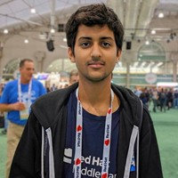


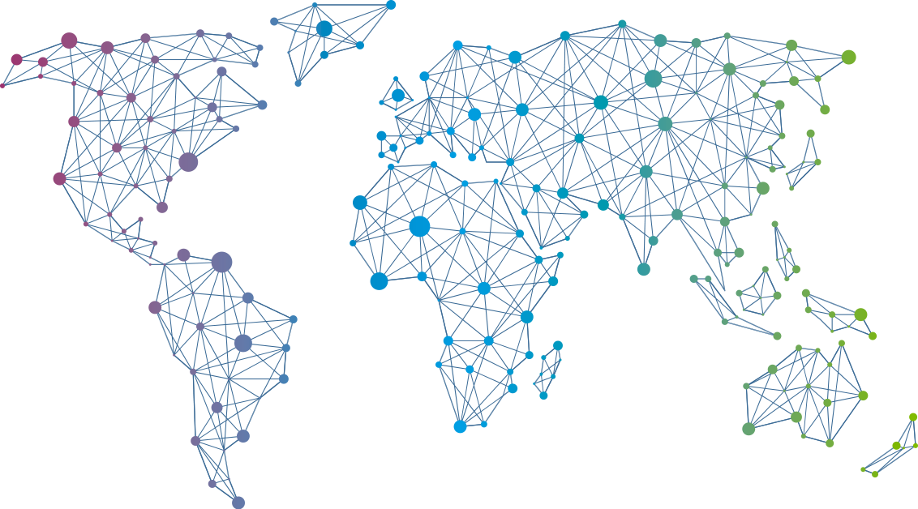

Speaker
Kunal Kushwaha
Scaling Communities to be more Inclusive
Kunal Kushwaha
kunalstwt
September 16th & 17th
^{Online Event}
Powered By
International Conference

